Slide 1
Exploring .NET
Gowtham K

Slide 2
Agenda
What is .NET?
What is .NET Framework?
.NET Framework Compilation
What is .NET Core?
Visual Studio IDE
Getting start with “Hello World”
What is IIS?
Deploy your web application in IIS

Slide 3
What is .NET?
It is a developer platform made up of tools, programming languages and libraries to develop different types of applications.
It has various implementation.
.NET Framework
.NET Core
Xamarin/Mono

Slide 4
What is .NET Framework?
It is a original implementation of .NET. It supports running websites, services, desktop apps and more on windows
It can work with several programming languages such as C#, VB.NET, F# and few dozen others .

Slide 5
.NET Framework Compilation

Slide 6
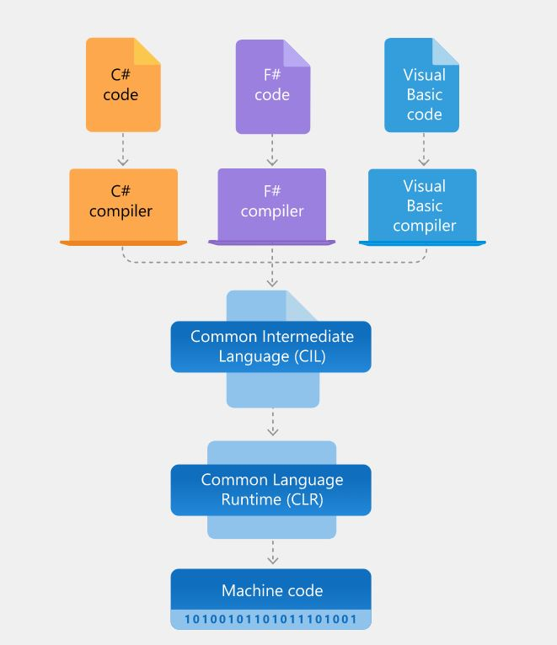
Source: https://dotnettec.com/

Slide 7
What is .NET Core?
It is a cross – platform implementation of .NET.
It supports running websites, microservices and console apps on Windows, Linux and macOS.
It is open source on GitHub.
Optimized for high performance and scalability

Slide 8
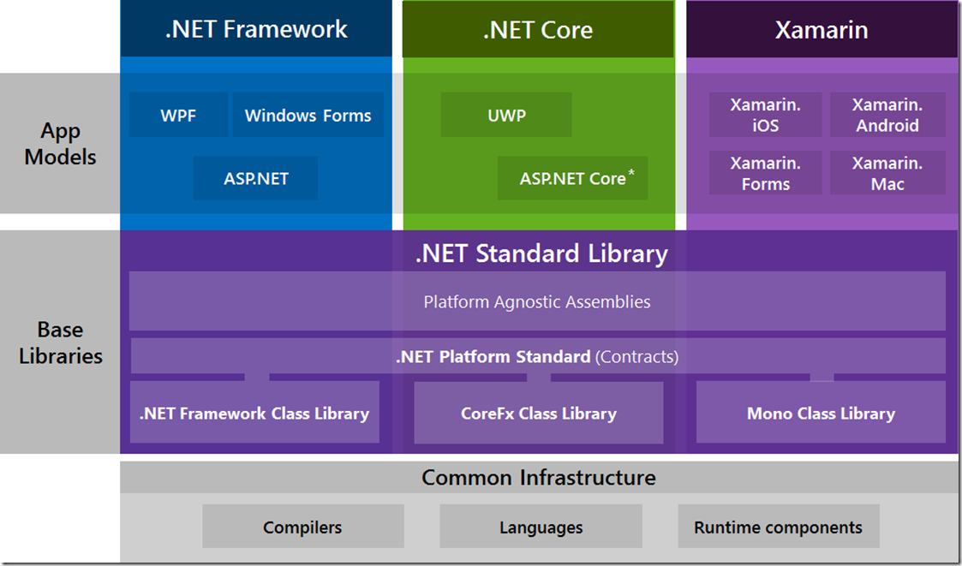
Source: https://devblogs.microsoft.com/

Slide 9
Visual Studio IDE
It is application development tool.
It supports different programming language like C#, C, C++, F#, VB . NET, JavaScript, TypeScript, Python…
Some of the feature of Visual Studio
Write your code fast
Debug and diagnose with ease
Collaborate efficiently

Slide 10
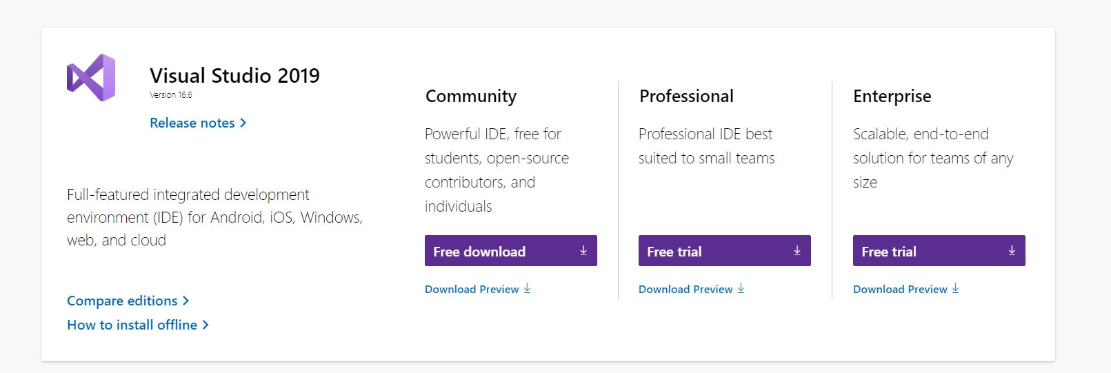

Slide 11
Demo

Slide 12
What is IIS?
Internet Information Service is an web server software created by Microsoft for use with windows NT family .
IIS Express is a lightweight version of IIS and it is a standalone freeware server.

Slide 13
Demo

Slide 14
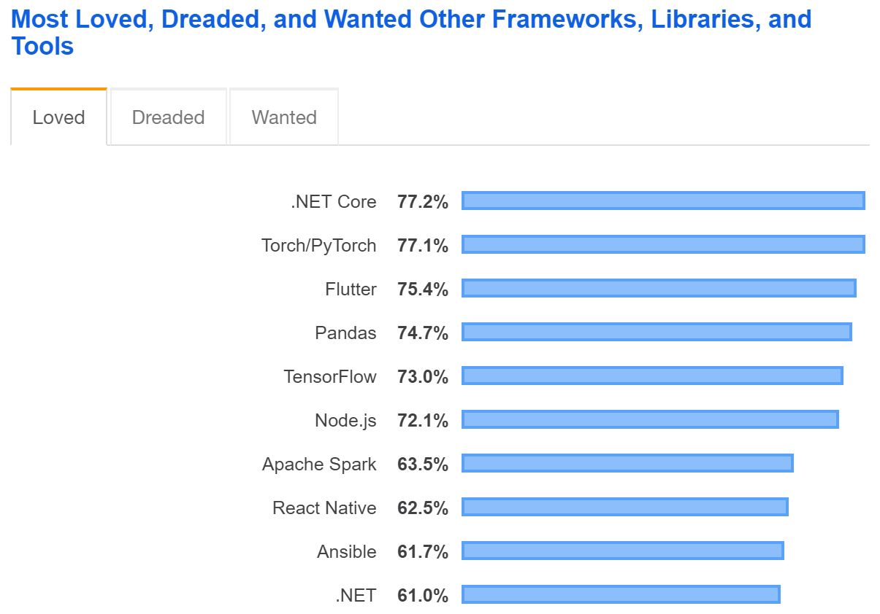

Slide 15
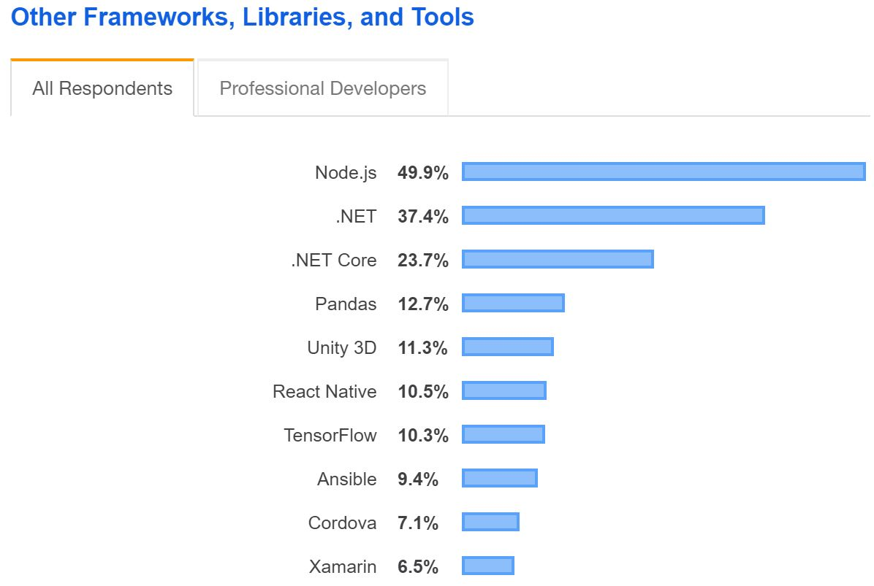

Slide 16
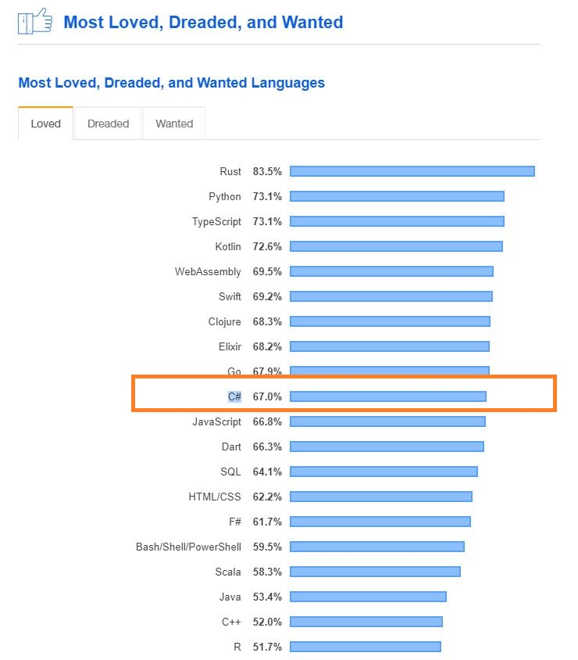

Slide 17
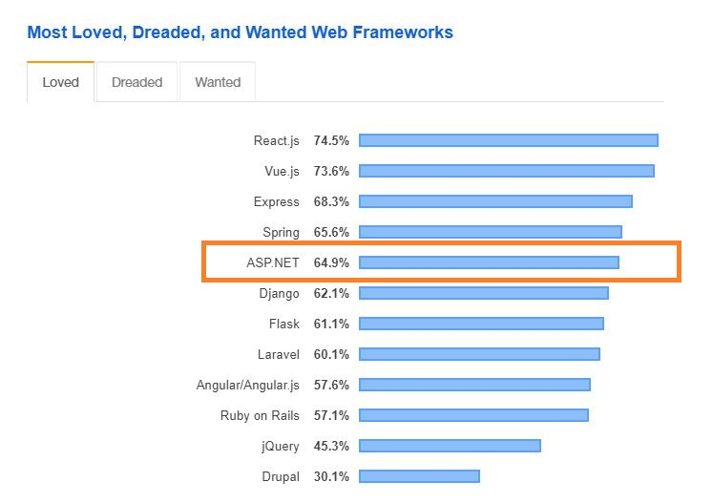

Slide 18
Q & A

Slide 19
Resource
Learn .NET
https://dotnet.microsoft.com/learn
https://docs.microsoft.com/en-us/learn/
Visual Studio
https://visualstudio.microsoft.com/downloads/

Slide 20
Stay Home. Stay Safe. Thank You.

